Slide 1
Army Research Institute
Measuring Community Embeddedness Near Army Installations: A Feasibility Study
DSPG Team: Jessica Keast, Sean Pietrowicz, Allegra Pocinki
SDAD Team: Stephanie Shipp, Joel Thurston, Advisors: Vicki Lancaster, Josh Goldstein, Nathaniel Ratcliff
Sponsor: Kelly Ervin, US Army Research Institute for Social and Behavioral Research
June 28, 2019

Slide 2
Community Embeddedness
“Community embeddedness refers to the attachments an individual worker maintains in a given area” (Munyon et al. 2019)
This project conceptualizes embeddedness as the degree to which Soldiers are connected (or disconnected) to the larger community and nation that they serve
Munyon, T. P., Madden, L. T., Madden, T. M., & Vigoda-Gadot, E. (2019). (Dys)functional attachments?: How community embeddedness impacts workers during and after long-term unemployment. Journal of Vocational Behavior,112, 35-50. doi:10.1016/j.jvb.2019.01.005
Notes:
Jessica

Slide 3
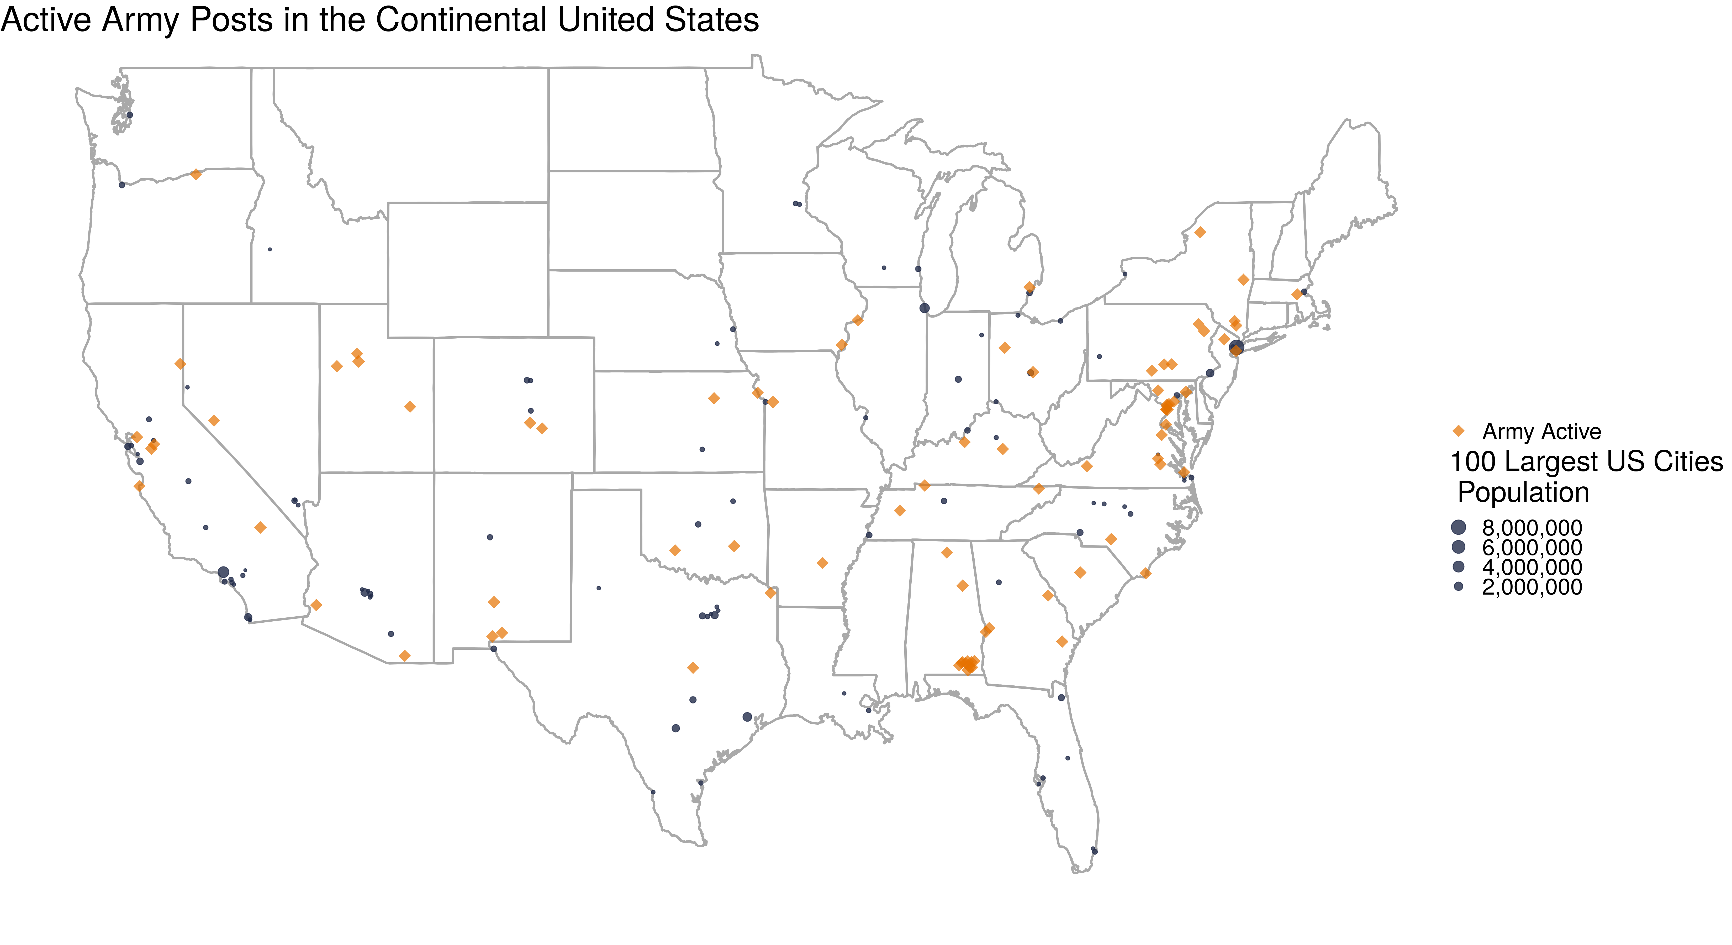
Project Summary
Project goal: Define and create composite indicators for community embeddedness
Why does community embeddedness matter to the Army?​
The ARI-SDAD collaboration seeks to understand the relationship between the Soldier’s community and Soldier performance and behavior​
Notes:
We are focusing on measuring the Federal Sources of R&D funding which represents about almost 25% of all sources of R&D fundind or $122 billion.

Slide 4
Research Questions
What is community embeddedness, and what characteristics of a community promote embeddedness? (from indicators and social media)
How does community embeddedness vary across locations? (from indicators)
Notes:
Jessica

Slide 5
Value to the Army
Community embeddedness may serve as an antecedent or enabler of Soldiers' development, reflecting the degree to which Soldiers have internalized core qualities of interest to the Army, such as:
Army Values (Selfless Service)
Soldier's Creed
“I am an American Soldier...
I serve the people of the United States, and live the Army Values...
I am a guardian of freedom and the American way of life”
Soldiers' health outcomes could potentially parallel community outcomes
Soldiers may also be found to be more susceptible to negative outcomes associated with embeddedness to the degree that Soldiers differ from the larger population

Slide 6
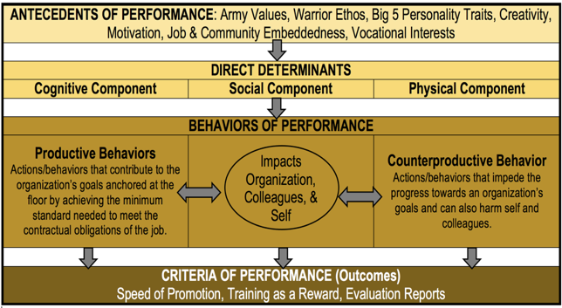
Conceptual Model of Performance & Behavioral Data Mapping
Notes:
SDAD is conducting research using multiple sources of DOD and Army data to create constructs to measure performance and behaviors.
This summer, we are working on one aspect of this measurement: How is community embeddedness defined? What are factors that define community embeddedness? If we can measure this, then we may include measures of community embeddedness in the constructs (the larger SDAD project)

Slide 7
Ethical Review
Problem Identification (Relevant Theories and Working Hypotheses)
Expected benefits: quantifying a social construct (community embeddedness) that isn’t currently measured for each county; no potential risks to participant welfare.
Assumptions: What characterizes a "good" or "embedded" community
Addressing these concerns by following common indicators already used in practice as well as controlling for race and income.
The IRB for this project has already been created and approved.
Data Discovery, Inventory, Screening, & Acquisition
Using data that has been sampled to represent the population and plan to apply survey weights.
Social media data might disproportionately skew towards younger individuals and those with higher education and income who have regular, reliable access to the internet.

Slide 8
Literature Review
An investigation into previous literature on embeddedness revealed several insights:
Previous studies collected survey data to measure job embeddedness and community embeddedness – using existing data
Previous studies focused on people in high turnover fields with many competitors
Grocery stores, hospitals are not analogous to the Army (interest in industry alternatives, networking behavior, employment shocks)
Overarching idea of community embeddedness remain relevant: social links made within an individual's community, quality of community fit, sacrifices made to live in community.
Without individual Soldier data, we are measuring overall community involvement around Army posts as a proxy for how involved Soldiers can become in these communities.
Notes:
An investigation into previous literature on this field of embeddedness revealed several insights:
Job embeddedness and community embeddedness have been calculated in previous studies from survey data collected for these specific studies. Our goal to create a metric using existing publicly available data will require a different approach.
Previous studies have interviewed employees of industries with high turnover and many competitors (grocery stores, hospitals, etc.). One's propensity to leave a high-turnover industry has been measured with several metrics that do not translate (interest in industry alternatives, networking behavior, employment shocks).
Overarching concepts of community embeddedness remain relevant: social links made within an individual's community, quality of community fit, sacrifices made to live in community. We sought to capture the spirit of these categories while utilizing publicly available data sources.
Without individual soldier data, we cannot apply the techniques developed by previous papers to measure embeddedness. Instead, we are measuring overall community involvement around Army posts as a proxy for how involved soldiers can become in these communities. Maximizing the appropriateness of this measure will be a primary challenge of this project.

Slide 9
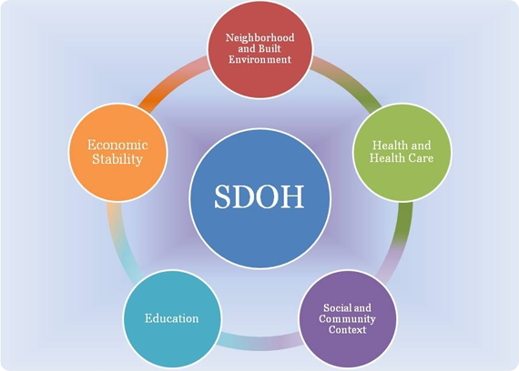
Research – Two Parts
1. Calculate indicators for counties in 2 states aligned with Social Determinants of Health
Compare community embeddedness indicators for all counties in Virginia with those counties that have Army posts
Compare differences between states (Oklahoma and Virginia)
Challenge – how to weight components of indicators?
2. Use social media data to supplement findings
Using ideas from indicators, search for terms related to community embeddedness
Challenge – Twitter requires approvals to obtain data; currently using blogs
Social Determinants of Health Framework
Source: https://www.healthypeople.gov/2020/topics-objectives/topic/social-determinants-of-health

Slide 10
Ideas for Community Embeddedness Composite Indicators
Neighborhood and Built Environment
housing characteristics: age, overcrowding, high housing costs, lack of kitchen/plumbing facilities
homeowners vs. renters
crime rates
air/water quality
residential segregation
commute time/distance
Open Street Maps: open space, sidewalks, playgrounds, parks
Health and Health Care
primary care physicians
teen births
infant/child mortality
preventable hospital admissions
insurance coverage
drug overdose deaths
reports of poor/fair health
Open Street Maps: liquor stores, fast food restaurants, fitness centers
Economic Stability
poverty status
employment status
income inequality
median income
food insecurity
Education
highest level of educational attainment
on-time high school graduation rate
early childhood education enrollment
Social and Community Context
membership associations
voting rate
racial/ethnic diversity
marriage rates
family size
library patronage
foster care entry
Open Street Maps: community centers, museums, religious institutions
Notes:
We are focusing on measuring the Federal Sources of R&D funding which represents about almost 25% of all sources of R&D fundind or $122 billion.

Slide 11
Data Discovery
Data source | Measures | Challenges | Keep/Shelve
American Community Survey | Social, economic, housing, and demographic characteristics | None | Keep
Virginia Department of Health, Injury & Violence | Deaths due to injury and violence | Have to request CSV files directly from Virginia Department of Health | Keep
County Health Rankings | Health outcomes, health behavior, socioeconomic factors, physical environment | None | Keep
Election Turnout, Individual Elections (Virginia) | Voter turnout data for general and special elections | None | Keep
Kids Count Data Center | Demographic indicators, economic well-being, education, health, safety for children | None | Keep
Public Libraries Survey | Public libraries within the U.S. | None | Keep
Open Street Maps | Location of various buildings and resources (e.g., open space, sidewalks, playgrounds, parks) | None | Keep
Notes:
We are focusing on measuring the Federal Sources of R&D funding which represents about almost 25% of all sources of R&D fundind or $122 billion.

Slide 12
Data Discovery
Data source | Measures | Challenges | Keep/Shelve
Number of Crimes by Offense Type (Virginia State Police) | Crimes by offense type, drug reports, hate crimes | Decent amount of missing data | TBD
General Social Survey (GSS) | Trends in attitudes, behaviors | Under contract, the GSS will provide data on State, PSU, County, Census tract. | Shelve, but are pursuing for future research
American Time Use Survey | How people spend their time on various activities including religious activities, socializing, unpaid childcare, housework, volunteering, etc. | Only national-level data | Shelve
Behavioral Risk Factor Surveillance System (BRFSS) | Health indicators | No county data – just state, metropolitan status | Shelve
National Health and Nutrition Examination Survey (NHANES) | Health and nutritional status of adults and children | All geography below national level is restricted. | Shelve
Department of Defense Education Activity (DoDEA) | Regional school calendars, enrollment data, accreditation reports, comprehensive assessment system, school report system | Lots of missing data for schools, no DoDEA schools near Army bases in Virginia | Shelve
Virginia Department of Health, Health Behavior | Health behaviors by health district | Geography grouped into health districts, which don’t correspond to any Census measure | Shelve
Notes:
We are focusing on measuring the Federal Sources of R&D funding which represents about almost 25% of all sources of R&D fundind or $122 billion.

Slide 13
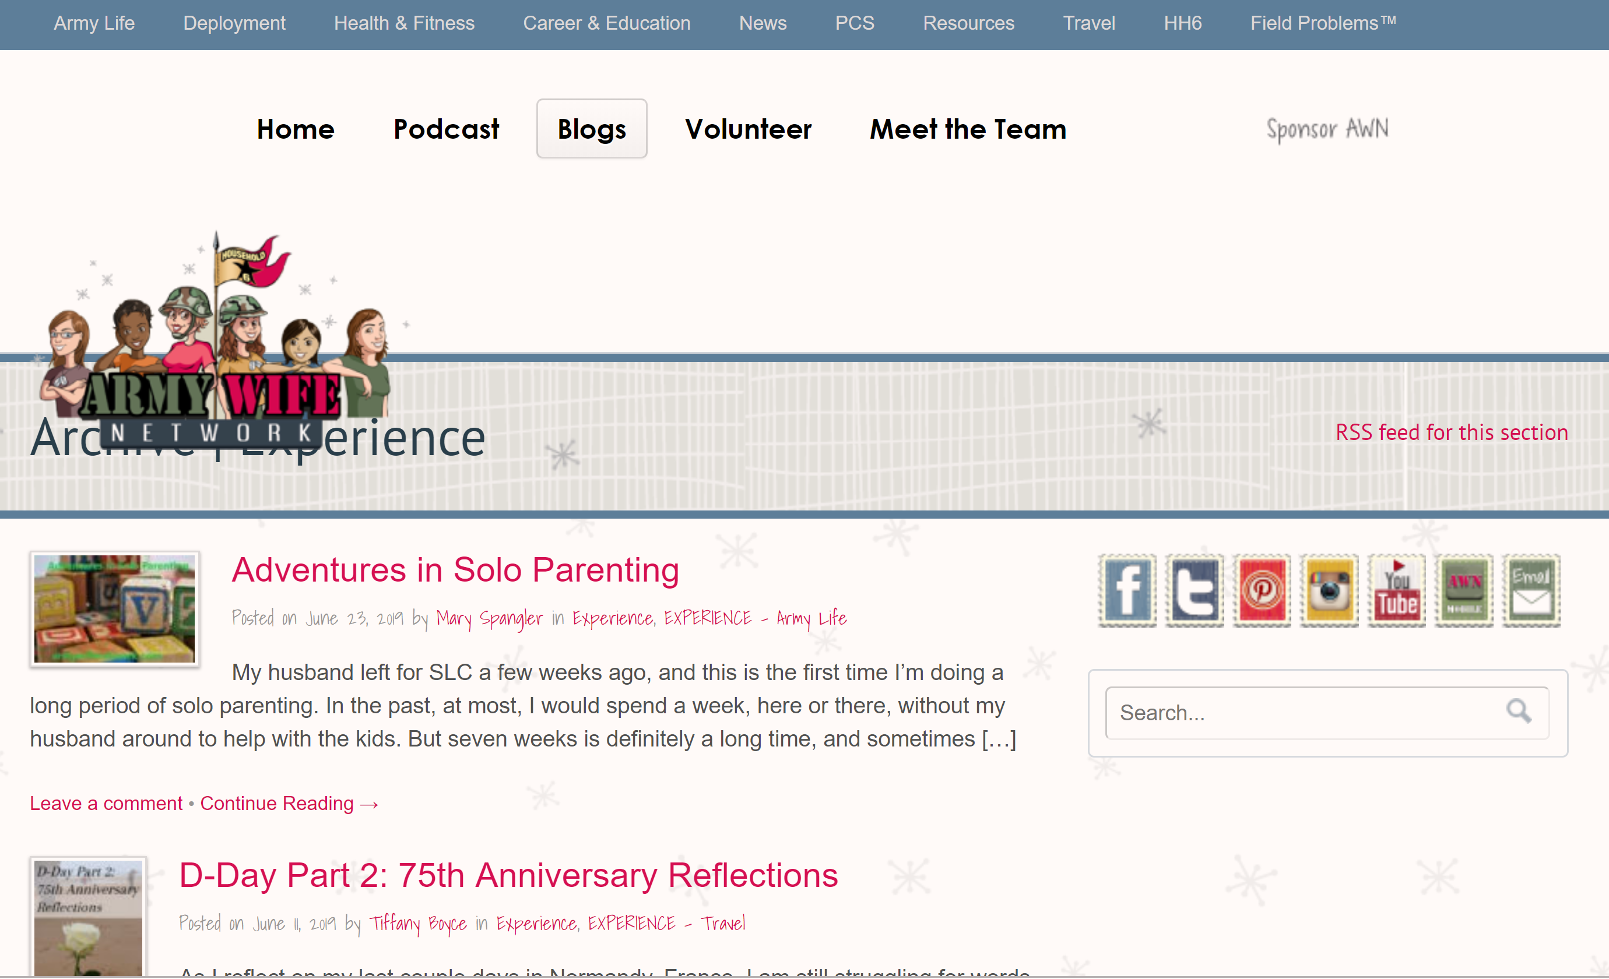
Social Media Sentiment Analysis
Interested in how often posts to social media are positive or negative
Identify keywords to search for discussions of community, social cohesion, what specific Army posts are being discussed

Slide 14
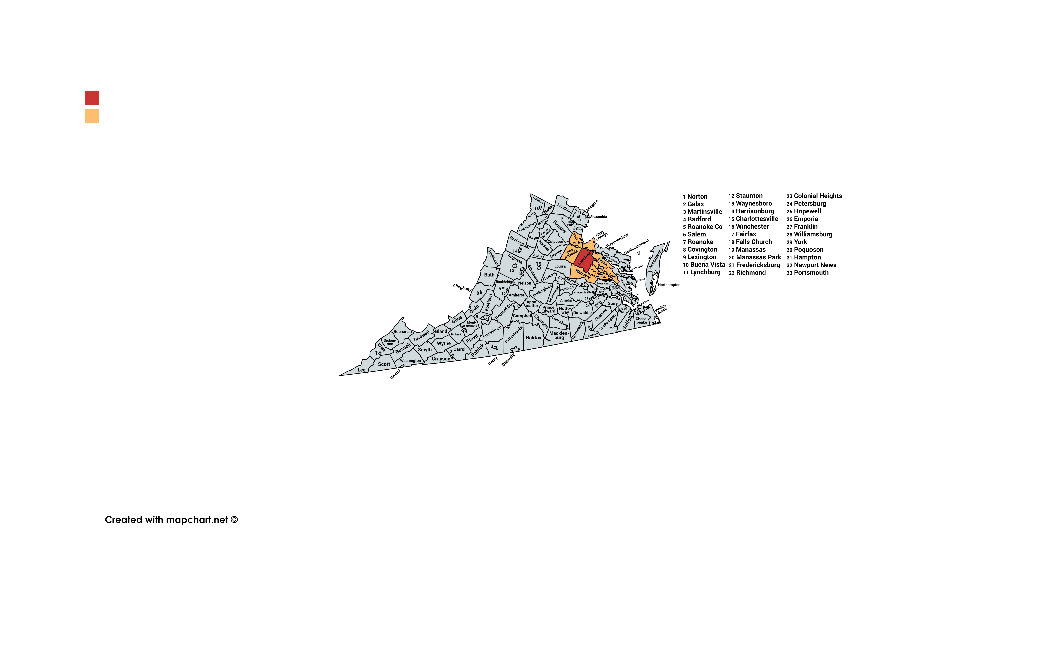
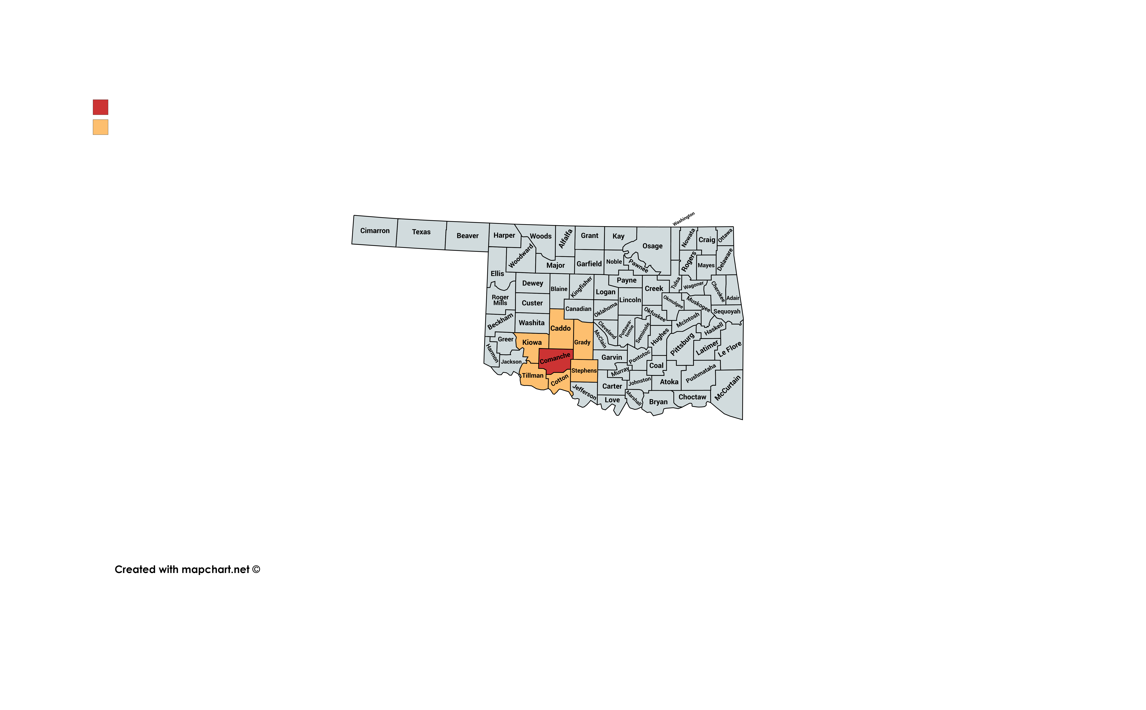
Army Post and County Selection
Ft. AP Hill (Virginia, Caroline County): Regional Collective Training Center; military units from across the U.S. are sent here for training
Ft. Sill (Oklahoma, Comanche County): home to the Field Artillery Training Command – all soldiers in Field Artillery receive their skills training here

Slide 15
Next Steps
1. Calculate indicators for counties in Virginia and Oklahoma
Create indicators using variety of data sources (American Community Survey, County Health Rankings, Open Source Maps, others)
Compare and analyze results within a state and between the two states
Determine weights (how were they calculated for County Health Rankings?)
2. Use social media data to supplement findings
Obtain data (likely blogs, maybe Twitter)
Identify keywords; conduct sentiment analysis; visualize results
Summarize findings - determine what types of discussions people are having about the Army and how they relate to community embeddedness

Slide 16
Appendix A: BRFSS and DoDEA Data
Why can’t we use these data sources for this project?
Behavioral Risk Factor Surveillance System (BRFSS): no county-level data; data available by state or metropolitan status (city, MSA, suburb, rural), which does not accurately encapsulate the area around each Army post.
DoDEA:
Regional school calendars shows the opening/closing dates for each school as well as holiday closings
Enrollment data provides total number of students in each grade, but there are no DoDEA schools in Virginia
Comprehensive assessment system provides average test scores/percentiles per school, missing data for many schools
Annual school report system provides performance data for Terra Nova exam, missing data for many schools
Accreditation reports are PDFs for each school that list criticisms of schools/areas for improvement, missing data for many schools (text could be useful for content analysis)
Notes:
Q – how does County Health Rankings use these data? We don't know – it just says they use BRFSS as a source, but you can't get any lower than MMSA. All we know is from BRFSS: A county name was collected from the respondent during the demographics section of the interview. The name of the county was used to determine the corresponding American National Standards Institute (ANSI) county code; this code was retained as a variable in the data set. The data record from an interview with a respondent was assigned to an MMSA on the basis of the county code.
https://www.cdc.gov/brfss/annual_data/2017/pdf/2017_SMART_BRFSS_MMSA_Methodology-508.pdf

